Slide 1
Scrum-Agile Methodology
CS250
Presented by John Grzeskowiak
Notes:
John Grzeskowiak SNHU CS250

Slide 2


Agile roles
Product Owner
Represents the customer & business needs
Defines requirements from user stories
Ensures team gives maximum effort
Scrum Master
Facilitates Scrum events
Removes obstacles
Teaches the team about Agile practices
Development Team
Developers & Testers
Responsible for building and test the product
Notes:
Each role is essential for a Scrum team to succeed. The Product Owner focuses on what should be built, while the Scrum Master focuses on how the team works, while the development team creates the product.

Slide 3

Agile Phases
Agile typical phases:
Requirements
User stories
Customer’s needs
Design
Features are designed
Development
Features are created
Testing
Continuous testing
Issues are fixed quickly
Deployment
Working software is released frequently
Review
Teams review completed work
Learn from previous problems for future sprints
Notes:
Both agile and the waterfall model go through the same stages. The main difference being that with Agile we go through these phases at each sprint, not just a single time throughout the entirety of the project.

Slide 4
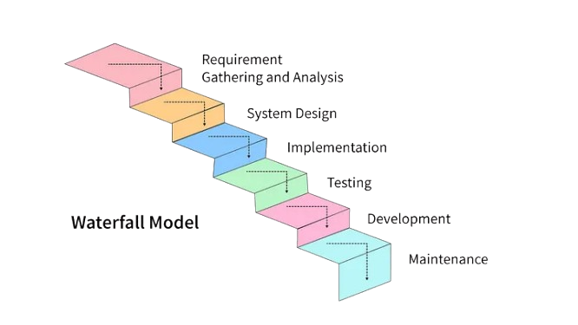
The waterfall model
Waterfall typical phases:
Requirements
Design
Development
Testing
Deployment
Maintenance
Characteristics
Sequential process
Requirements are defined early
Limited customer involvement after planning phase 1 and 2
Changes are difficult and costly
Notes:
The waterfall model follows a strict, linear path where progress must only move forward when the previous phase has been completed, or else you start from requirements phase again (phase 1). Teams usually won’t revisit past work in a waterfall model unless they are willing to start nearly from the beginning, having to do a lot of rework.

Slide 5
Waterfall vs. Agile
How to choose?
Waterfall:
Resists change
Requirements are clearly defined
Scope of project is unlikely to change
Regulatory documentation is required
Predictability > Flexibility
Agile:
Welcomes change
Requirements may change
Frequent customer feedback is necessary
Speedy development
Flexibility and innovation are priorities
Notes:
The best option will always depend on the project. For example, a travel company may be more focused on their product being released quickly and aren’t 100% sure as to what the finished project will look like (agile), whereas one isn’t on a time crunch but knows exactly what kind of product they want (waterfall).

Slide 6
References
Atlassian. (2025a). Agile Best Practices and Tutorials. Atlassian. https://www.atlassian.com/agile
Atlassian. (2025b). Waterfall Methodology for Project Management. Atlassian. https://www.atlassian.com/agile/project-management/waterfall-methodology
Mackie, C. (2024, October 16). The 3 Key Roles in an Agile Team. Easyagile.com. https://www.easyagile.com/blog/agile-team
Van der Hoek, J. (2021, October 11). Agile Explained: The 5 Stages of the Agile Development Lifecycle. Mendix. https://www.mendix.com/blog/agile-software-development-lifecycle-stages/
Notes:
References

